Slide 1


A PERSONAL VOICE-ACTIVATED DESKTOP ASSISTANT

Slide 2

Aayush Adhikari
Mayank Gupta
Mitali Gupta
Karan Jain
OUR TEAM
Computer Science engineering AIML
Computer Science engineering AIML
Computer Science engineering AIML
Computer Science engineering AIML

Slide 3
Acknowledgement
In this research, we created a voice assistant that can perform any task in exchange for requests from users without making any mistakes. More capabilities have been added, such as the ability to listen to the user's voice.
Exclusively, and will not be activated by noise in the environment. This project's modular design makes it simple to modify, understandable and adaptable. We can expand the program's capabilities without affecting its functionality.

Slide 4

ABSTRACT
A voice assistant is defined a digital assistant that combines artificial intelligence, machine learning Speech Recognition, Natural Language Processing (NLP), Speech Synthesis and various actuation mechanisms to sense and influence the environment.
Our virtual assistant focuses on removing the need for the user to type text input and instead relying on speech as the primary mode of user input.

Slide 5

Introduction
Almost all duties are now digitalized in today's world. We have a Smartphone in our hands, and it's like having the entire world at our fingertips. We don't even use our fingers anymore.
We just speak of the task and it is done. There are procedures in place where we can text Dad and say, "I'll be late today." And the text is sent. A Virtual Assistant's job is to do just that. It also helps automate search, discovery, and online purchase processes by supporting specific tasks such as booking a trip or locating the cheapest book online from several eCommerce sites and then giving an interface to place an order.
Virtual assistants are software programs that assist you with day-to-day duties such as weather forecasting, setting reminders, and preparing shopping lists, among other things. They can accept text (online chatbots) or voice commands. To activate the listener, voice-based intelligent assistants require an invoking phrase or wake word, followed by the command. There is a plethora of virtual assistants available, including Apple's Siri, Amazon's Alexa, and Microsoft's Cortana

Slide 6

Proposed System
Our virtual assistant focuses on removing the need for the user to type text input and instead relying on speech as the primary mode of user input. The agent then records the input after applying voice recognition techniques to it. It then uses this information to call one of the personal information management programs, such as a task list or calendar, to create a new entry or to conduct a search on Google, Bing, or Yahoo, among others. The emphasis is on gathering user input via voice, recognizing it, and then completing tasks if the agent understands them. Software interprets this data in normal language, making it easier for the user to specify what he or she wants done.
Voice recognition software enables hands free use of the applications, lets users to query or command the agent through voice interface.

Slide 7
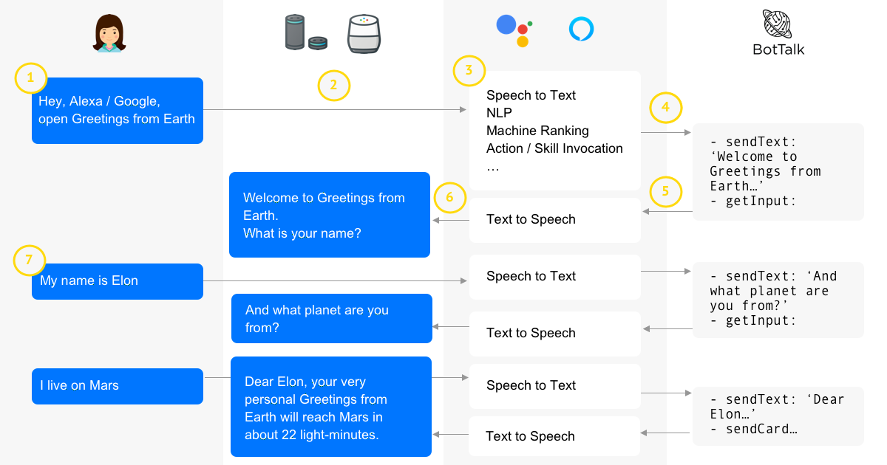

Slide 8
Methodology
An application of a natural language processing-based intelligent voice assistant system that may be used to transmit text messages. Messages may be sent and received, and the device's other applications can be used on the platform of was designed and implemented utilizing python android.

Slide 9
Tasks that are supported
Search something on internet. | Write an email. | Play a certain song | Make a new note
Open an application | Can tell the current temperature of CPU | Shutdown or Restart PC | Can tell a joke to lift up users mood

Slide 10
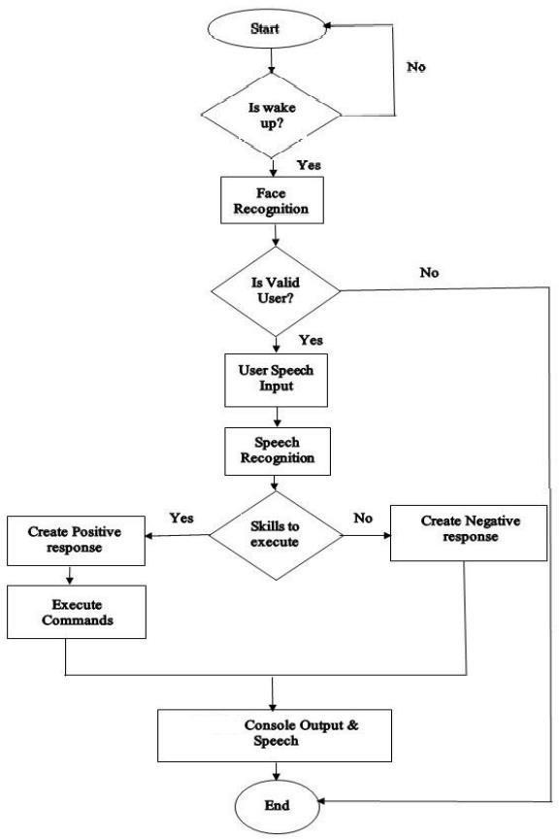
FLOWCHART:

Slide 11
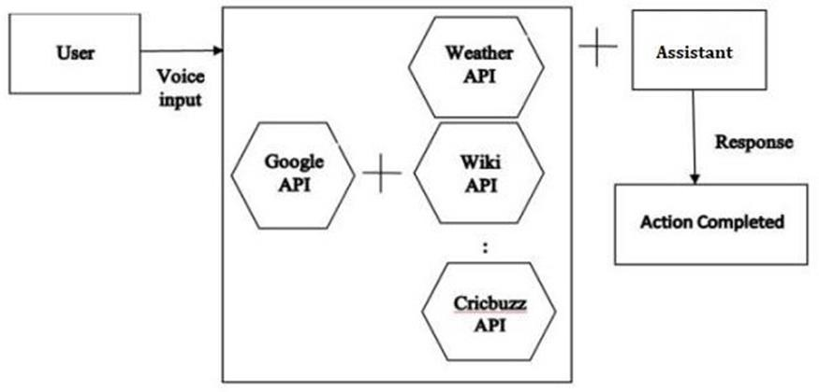
Data Flow

Slide 12
Modules Used
-Psutil
-Json
-Speech Recognition
- PyAudio
- gTTs
-Datetime
- Wikipedia
-Web Browser
-OS
-PyJokes
-Smtlib
-Requests

Slide 13
Future Scope
Virtual assistants are now available and are quick and responsive, but there is still a long way to go. The present systems' understanding and dependability must be improved. It has vastly improved.
With the addition of these, we shall be able to reach new heights thanks to technological advancements. What really is the situation?
Today's aides are still insufficient. In critical situations, it's dependable.
These helpers' future will be bright. Artificial Intelligence (AI) should be implemented into virtual assistants. Machine Learning and Neural Networks are examples of intelligence. IoT and networks, for example
What virtual assistants can accomplish is far beyond what we now have, achieved up until now Jarvis is a virtual reality that most of us have seen

Slide 14
Conclusion
The Contact’s Application is used to store the client's contact details and also encourages the customer to make a call or send an SMS to other people individual who is using the chemical stored in this app
The desktop assistant's efficiency has been greatly increased in terms of functionality, and it also monitors the user's security using voice recognition technologies.
It's called advanced desktop assistant since it includes a lot of sophisticated capabilities that Microsoft Cortana doesn't have.
With significant features, this assistant is also focused on the user interface, which is necessary because Cortana lacks a user-friendly interface. A new desktop assistant is required to provide next-generation services, allowing us to make desktops as user-friendly as mobile devices.

Slide 15
References
Python Programming -Kiran Gurbani
Learning Python – Mark Lutz
Hands-on Machine Learning with Scikit-Learn (O’Reilly)
Books Referred:
Website referred:
. YouTube Channels Referred:
www.stackoverflow.com
www.pythonprogramming.net
www.codecademy.com
www.tutorialspoint.com
Code with Harry
Edureka!
Programming with Mosh

Slide 16
Documents Referred
C.K. Gomathy. (2010),"Cloud Computing: Business Management for Effective Service Oriented Architecture" International Journal of Power Control Signal and Computation (IJPCSC), Volume 1, Issue IV,
Mohit Bansal, Dr. T. K. Thivakaran, “Analysis of Speech Recognition using Convolutional Neural Network”, Journal of Engineering Sciences, Vol 11, Issue 1, 2020, Page 285-291.
C K Gomathy and V Geetha. Article: A Real Time Analysis of Service Based Using Mobile Phone Controlled Vehicle Using DTMF For Accident Prevention. International Journal of Computer Applications 138(2):11-13, March 2016. Published By Foundation of Computer Science (FCS), NY, USA, ISSN No: 0975-8887
Ossama Abdel-Hamid, Abdelrahman Mohamed, Hui Jiang, Li Deng, Gerald Penn, and Dong Yu, “Convolutional Neural Networks for Speech Recognition”, IEEE/ACM Transactions on Audio, Speech, and Language Processing, vol.22,2010.
Dr. Jaydeep Patil, Atharva Shewale, Ekta Bhushan, Alister Fernandes, Rucha Khartadkar, "A Voice Based Assistant Using Google Dialogflow and Machine Learning", International Journal of Scientific Research in Science and Technology (IJSRST), Online ISSN : 2395-602X, Print ISSN : 2395-6011,
Nil Goksel-Canbek2 Mehmet EminMutlu, “On the track of Artificial Intelligence: Learning with Intelligent Personal Assistant” International Journal of Human Sciences, 13(1), 592-601. doi:10.14687/ijhs.v13i1.3549.

Slide 17

THANK YOU!

